Slide 1

Healthcare
Project Management
New book available June 2013
Kathy Schwalbe, Ph.D., PMP
May 16, 2013
Madison PMI PDD
schwalbe@augsburg.edu www.healthcarepm.com

Slide 2
Presentation Outline*
The need for better project management in the healthcare industry
Framework for project management
Similarities and differences in managing projects in healthcare
Sample outputs for initiating, planning, executing, monitoring and controlling, and closing a healthcare project
Time permitting: Options for project management software
*Note: Materials are from my upcoming book with co-author Dan Furlong,
Healthcare Project Management. Slight changes made; posted on healthcarepm.com.

Slide 3
The Need*
Healthcare spending was 17.9% of U.S. GDP in 2010, an average of $8,402 per person
The Centers for Medicare and Medicaid Services (CMS) estimates that healthcare spending will grow to about 19.8% of GDP by 2020
Compared to other Organisation for Economic Co-operation and Development countries, the U.S. spends 48% more on healthcare compared to the next highest country, Switzerland
*The Henry J. Kaiser Family Foundation. Healthcare Costs: A Primer, Key
Information on Healthcare Costs and Their Impact. 2012.

Slide 4
The Triple Aim*
Improving the U.S. healthcare system requires simultaneous pursuit of three aims:
Improving the experience of care
Improving the health of populations
Reducing per capita costs of health care
*Donald M. Berwick, Thomas W. Nolan, Whittington J. The Triple Aim:
Care, Health, And Cost. HealthAffairs. 2008;27(3):759-69.

Slide 5
Patient Protection and Affordable Care Act (PPACA or ACA)
This March 2010 Act resulted in incentives and enablers for the implementation of Electronic Medical Records, associated meaningful use, resultant procedural changes, and Health Information Exchanges
All of these initiatives coupled with movements to patient-centered care, evidence-based medicine, centers of excellence, and other forces bearing down on the healthcare industry have spawned a current climate of what may be an unsurpassed number of healthcare projects going on within the U.S. and globally

Slide 6
What’s Needed
Public health and healthcare leaders need to:
  Work on the right stuff
  Get the most bang from every buck
  Make investments in IT, infrastructure, and quality improvements that will allow them to reduce costs
and good project management can help!

Slide 7
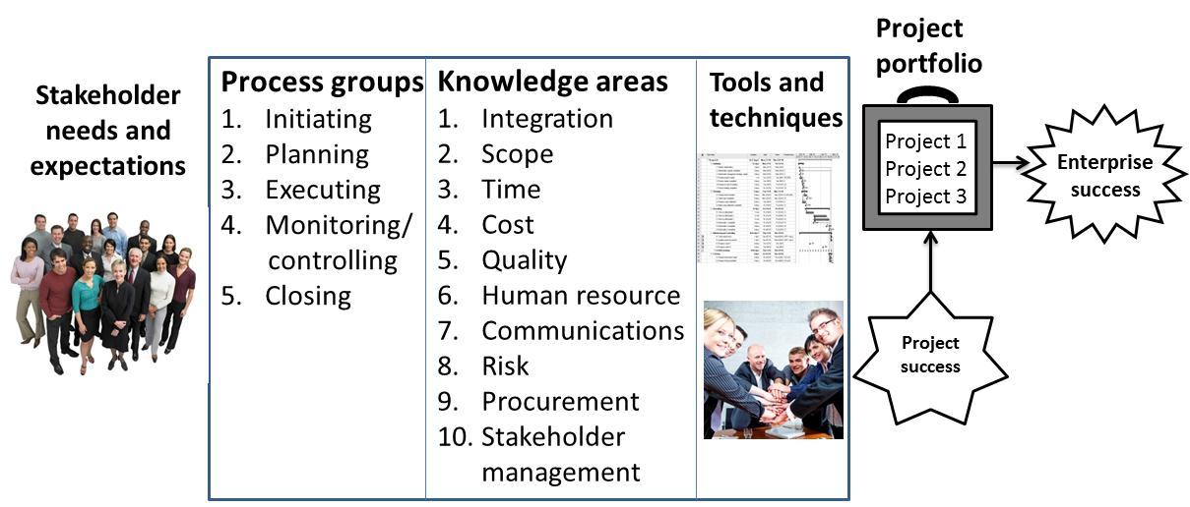
Project Management Framework*
*Kathy Schwalbe, An Introduction to Project Management, 2012.

Slide 8
Similarities in Healthcare Projects
Projects still include all 10 knowledge areas and 5 process groups
Projects have the same attributes and constraints
The same tools and techniques apply
Consumers keep expecting more for less

Slide 9
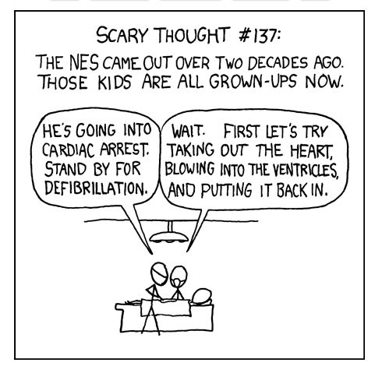
Source: xkcd.com

Slide 10
What’s Different About Healthcare Project Management?
There are two “camps” of people: clinical/philanthropic vs. enterprise marketplace viability and sustainability
Care quality, cost containment, and external review are key characteristics
  Quality of care for the patient is a key concern, so risk-aversion is more common; quality often wins over other constraints
  Government and regulatory agencies often play a big role
  Finances are even more complex; hard to measure costs
Healthcare is very personal and controversial
Deliverables and metrics are different: outcomes and processes must both be measured
Increasing collaboration across entities is difficult but needed

Slide 11
Findings from Recent Study*
Healthcare workers do not understand the differences between service work and project work. They understand activities to provide better service to patients, but they have not been trained to make more radical, disruptive changes that challenge the status quo.
Healthcare projects are done to create something that is delivered to the organization, unlike operational work which produces outcomes aimed at patients. “In other words, it is only once the project’s outcome is implemented and becomes ‘the new way we work now’ that it starts exerting its impact on patients.”
*Francois Chiocchio et al, “Stress and Performance in Health Care Project Teams,” Project Management Institute (2012)

Slide 12
Suggestions from Recent Study
Train healthcare workers on PM, emphasizing collaborating on achieving project goals and understanding their roles on project teams, which may differ from their roles in their day-to-day work.
Management also needs to structure project teams by properly planning workers’ time and payment to allowing them to successfully engage in project work.

Slide 13
Example Video Highlight: Rooting Out Waste in Health Care by Taking Cue From Toyota
When the Virginia Mason Medical Center in Seattle was losing money for the first time in its history, CEO Dr. Gary Kaplan, MD, turned to Toyota to learn how to root out waste
For example, they are trying to totally eliminate waiting rooms. If there are a lot of people in a waiting room, you know that the workflow is inefficient. They now has workflow managers who help minimize waste, including the waste of patients’ time.
Some of the tangible benefits of reducing waste include a reduction in liability costs by 60% since 2004 and improved patient care. Also, the amount of time nurses spend in direct contact with patients has increased from only 35% to 90%.
Virginia Mason Medical Center is now among the top 5 percent of more than 4,500 hospitals nationwide for clinical performance.
Note: You can see this and other videos from healthcarepm.com

Slide 14
Sample Outputs in New Book
A running case in my text, Ventilator Associated Pneumonia Reduction (VAPR), includes examples of project management outputs in each process group, including:
  Initiating: business case, charter
  Planning: project management plan, scope statement, requirements traceability matrix, WBS, project schedule, cost baseline, quality metrics, human resource plan, project dashboard, risk register, supplier evaluation matrix, stakeholder management plan
  Executing: deliverables, milestone report, change requests, project communications, issue logs
  Monitoring and controlling: earned value information, accepted deliverables, quality control charts, performance reports
  Closing: project completion form, final project report, transition plan, lessons-learned report, contract closure notice

Slide 15
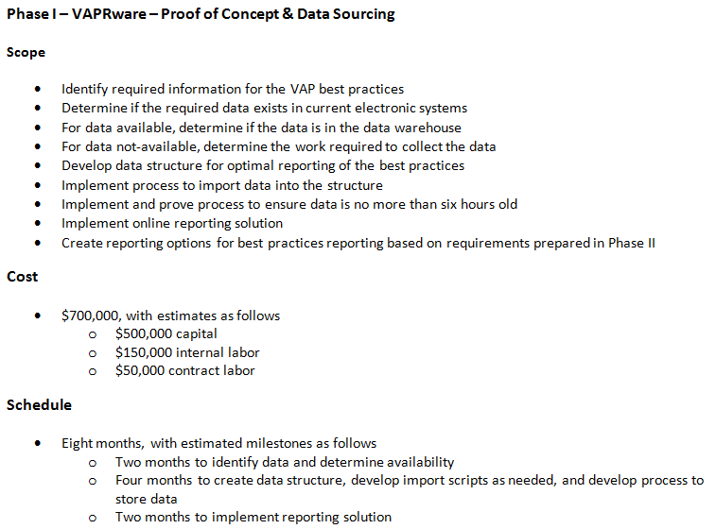
VAPR Project Summary Phase I-Technical
©2013 Schwalbe Publishing

Slide 16
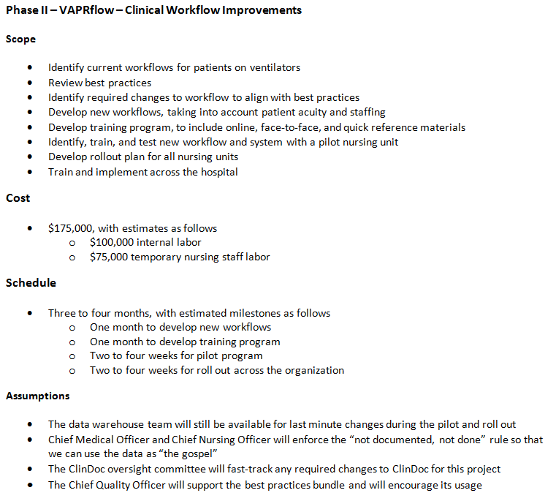
VAPR Project Summary Phase II-Clinical
©2013 Schwalbe Publishing

Slide 17
Project Charter
©2013 Schwalbe Publishing
Project Title:
Ventilator Associated Pneumonia (VAP) Reduction – “VAPR”
Project Timeline:
Start: July 1 Projected Finish Date: June 30
Purpose:
VAP costs AHS $3.6M per year and puts our patients at risk for severe and sometimes fatal consequences. VAP is considered preventable by CMS, having worked with the Institute for Healthcare Improvement to develop a set of best practices that, if followed, has been proven to reduce VAP by 50% in other healthcare facilities. AHS will implement a system to collect and report compliance with the best practices in order to better manage VAP in order to better serve our patients healthcare needs. VAP is no longer reimbursable by CMS or major payers as of July 1, which will also put a financial burden on our organizations.

Slide 18
Project Charter (continued)
Budget
The VAPR project is expected to cost $980,000 over one year, with a total TCO of $980,000 over three years.
Project Manager
VAPR has been broken down into two phases. The first phase is a proof of concept and the data collection/reporting system and will be managed by Jeff Birdwell, PMP from the PMO’s office. The second phase includes clinical process reengineering, training, and monitoring and will be managed by Pat Wager, RN, from the analytics department.
Success Criteria
This project will be considered successful if the VAP incidence rate drops by at least 50% within six months of implementation. Incidence rates will be determined based on the number of VAP events per 1000 ventilator days. Another success criterion is a sponsor rating of 8 or higher with a high of 10.
Approach
All work to be completed by internal staffing, where possible.
Project to be broken up into two major phases that will overlap their work, requiring the two project managers to work closely together throughout the project.
Etc.

Slide 19
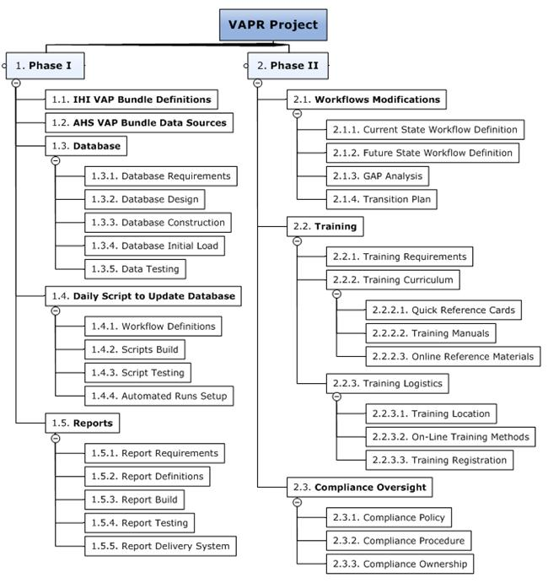
Draft WBS
©2013 Schwalbe Publishing

Slide 20
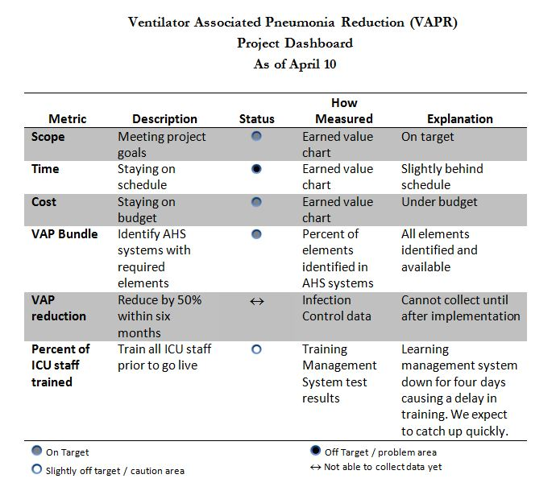
©2013 Schwalbe Publishing

Slide 21
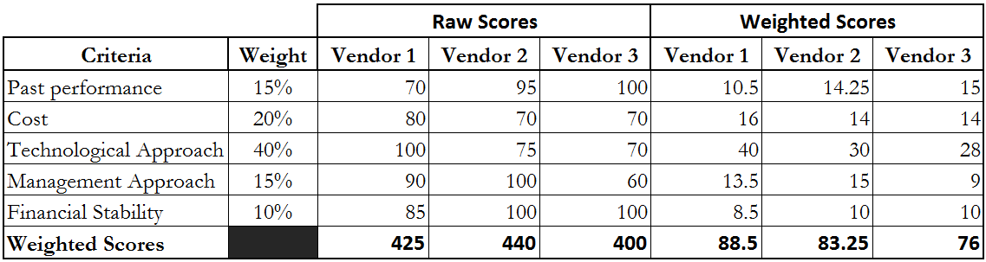
Supplier Evaluation Matrix
©2013 Schwalbe Publishing

Slide 22
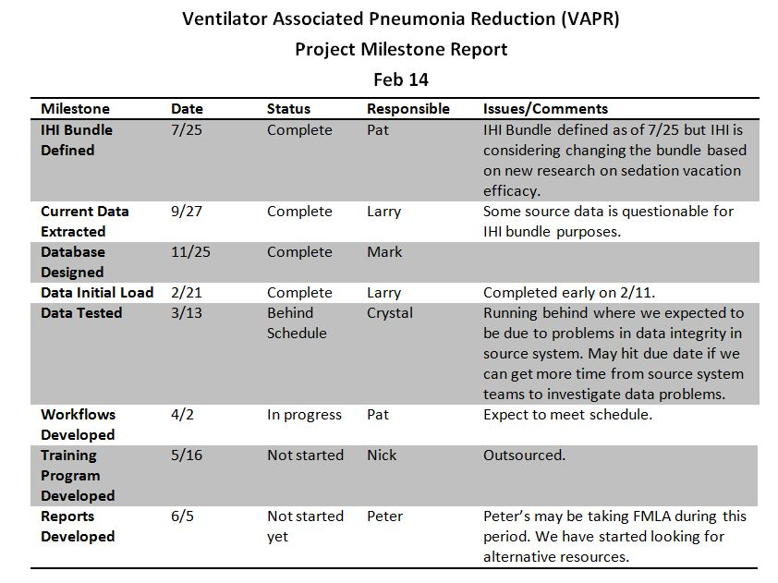
©2013 Schwalbe Publishing

Slide 23

Cause and Effect Diagram
©2013 Schwalbe Publishing

Slide 24
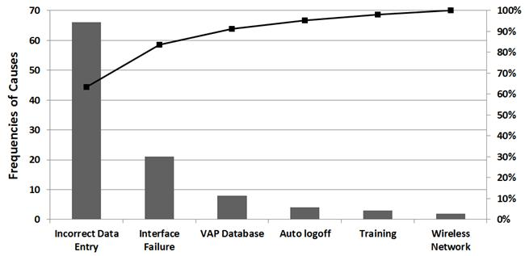
Pareto Diagram
©2013 Schwalbe Publishing

Slide 25
More Resources
FREE companion Web site for Healthcare Project Management includes
  Over 60 template files
  Links to great videos
  Interactive quizzes
  www.healthcarepm.com

Slide 26
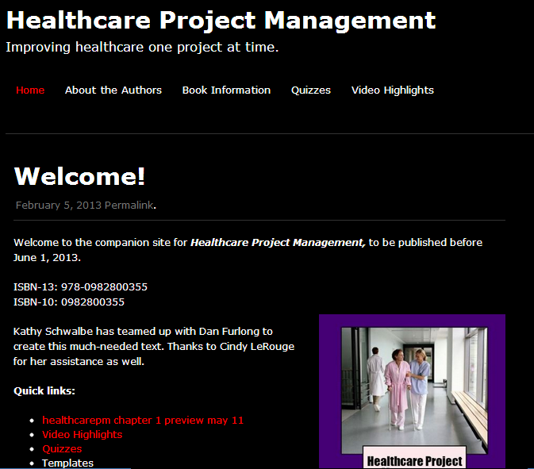
Note: These updated slides are under Book Information

Slide 27

Options for Project Management Software
Project 2013 now available, also includes Project Online
Lots of other software available
The real issue is planning projects well, communicating info, and getting work done!
“A fool with a tool is still just a fool!”

Slide 28
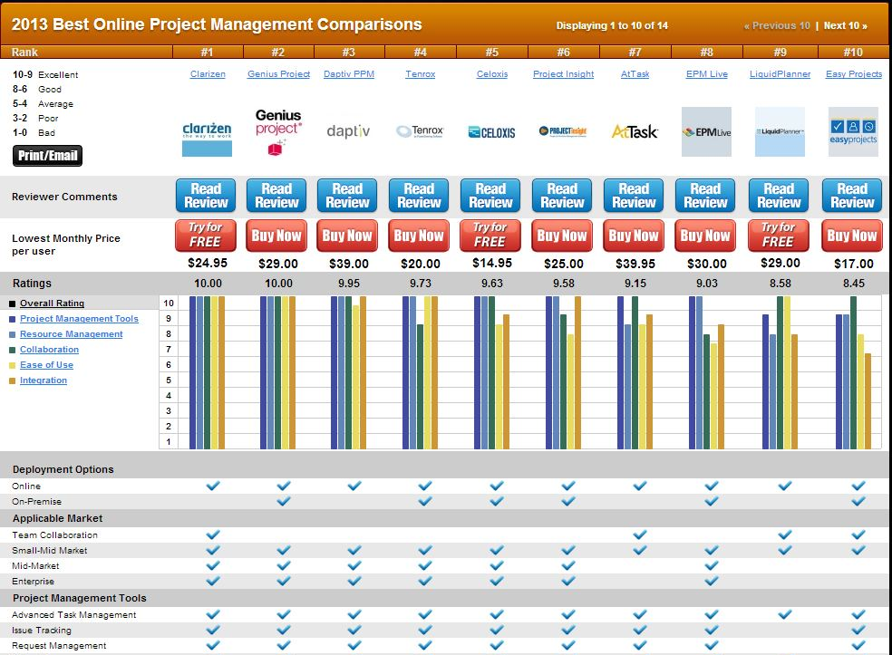
Top Ten Reviews

Slide 29
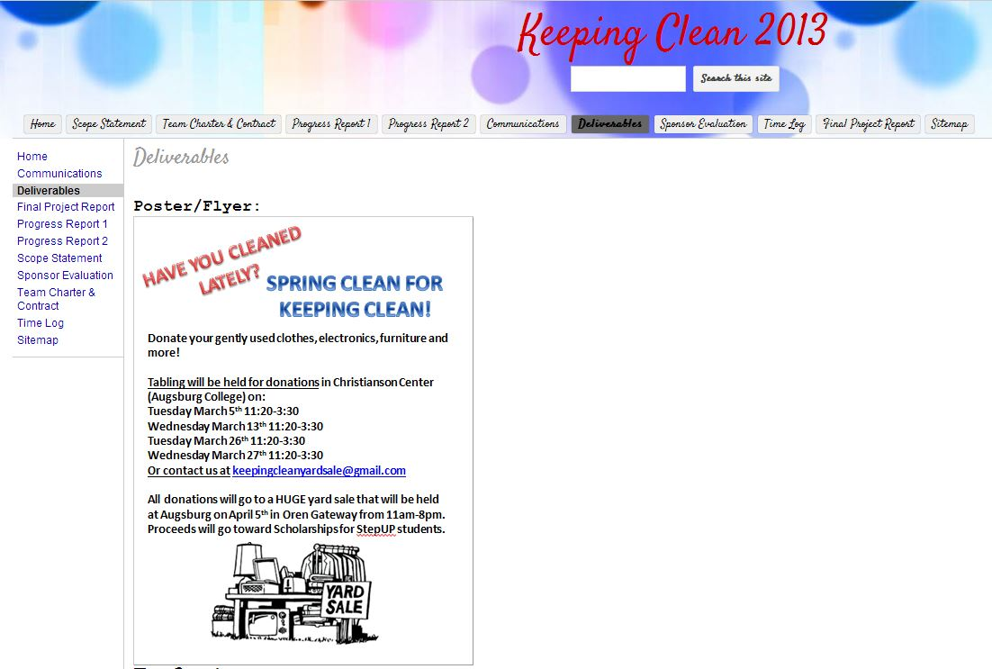
Lots of Free Tools to Aid in Colloration
Actual Google site from a class project. Team used Google docs to estimate and track hours, prepare charter, progress reports, etc.

Slide 30
Conclusions
The healthcare industry in general is behind most other industries in terms of project, program, and portfolio management.
There’s a huge need to educate people in managing the many healthcare-related projects.
We can improve healthcare in this country one project at a time!

Slide 31
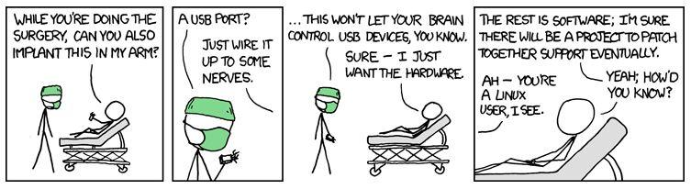
Too bad we can’t implant software to make us all smarter – yet!
Source: xkcd.com

Slide 32

Questions/Comments?
www.healthcarepm.com

